Slide 1
EURO
2.3.16

Slide 2
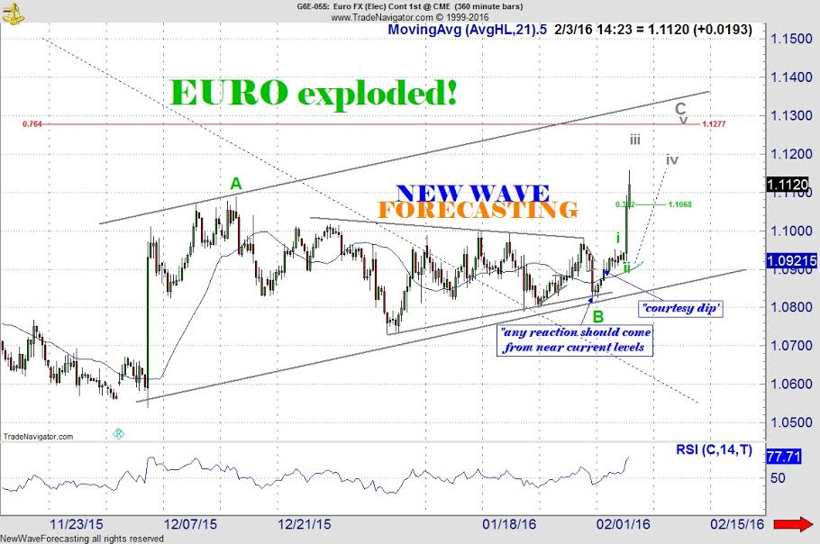
Euro 1.1125 higher still, but dippy
14:23 2.3.16
I think I have the best count now and it places prices moving sharply higher in wave C which should make the upper 76 near 1.1275. I place support near 1.1075 if there is a downdraft later on.

Slide 3
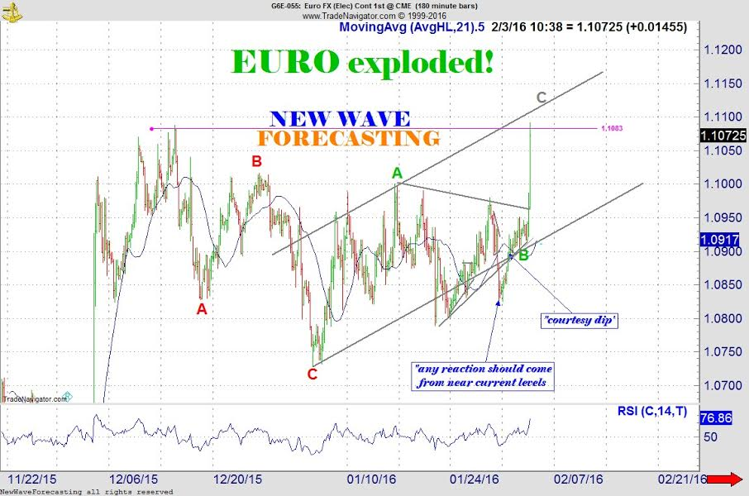
Euro 1.1070 Higher Still
10:38 2.3.16
At least I spotted this one! The algorithms move almost as fast as the speed of light so it may be tough to nail down a short term count. I think higher prices are likely but perhaps the rate of ascent will slow. If 1.11 gets a visit we'll take a look

Slide 4
Euro 1.0975 EXPLOSIVE POTENTIAL
08:24 2.3.16
The mere fact the the ECB and the Fed are valiantly fighting to keep the Euro down for whatever reasons natural market forces want it to go higher. It seems crystal to me that the 1.05-1.10 is the target zone. A few months ago I put out some forecasts that said the Euro was going to be 1.25 by Christmas so I am not just puffing it out now.
IF 1.10 is the upside tipping point AND the central banks have lost control the market could have a violent rally!

