Slide 1
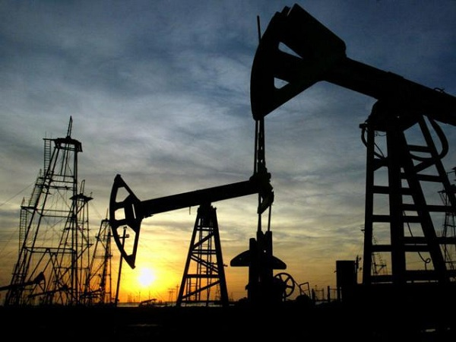
2.8.16
Crude Oil

Slide 2
Crude 29.75 Vulnerable towards $28
14:36 2.8.16
Prices are back in the passive buyer zone but this time I am open to the possibility that the market will fall out the bottom. This could lead to a quick drop towards 28 if it plays out this way.

Slide 3
Crude 30.30 Buy interests remain below 30
10:47 2.8.16
Being short NatGas below 2.00 was a horrible play and being short crude below $30 may have offered some opportunities for now it is a risky play. I still think 30.80 is probably the key nearby level above which prices need rally to take the bearish edge off.

Slide 4
Crude 30.10 testing big support
08:57 2.8.16
The last pair of sub $30 visits were death traps for sellers and it simply remains to be seen if the market will hold together or not. In this case the Uber bearish view is a head and shoulders pattern with an objective below $24 with a likely stop at 28.25 along the way.

Slide 5
Crude 3.090 UN anticipated new low
14:37 2.5.16
I did not see this coming and I am not sure how bearish it is but it ain't good...B waves are almost always tough and the 30.325 lower 76% target will no change but the map in that direction will...

Slide 6
Crude 31.75 heading sideways / up
13:06 2.5.16
The setback came right to the top of the bear trap and held confirming my view that the low was in. Whether this market can rally a buck this afternoon seems dubious to me so maybe a triangle will develop and we continue up Monday. This ought to at least not hurt the equity markets.

Slide 7
Crude 31.95 and working higher in detailed forecast
10:55 2.5.16
I have no doubt that the low in crude is in for today at least. This has allowed me to build a rather detailed forecast which is basically up towards 32.50 and then down towards 30.50 and then up towards 33/33.50. Time will tell!

Slide 8
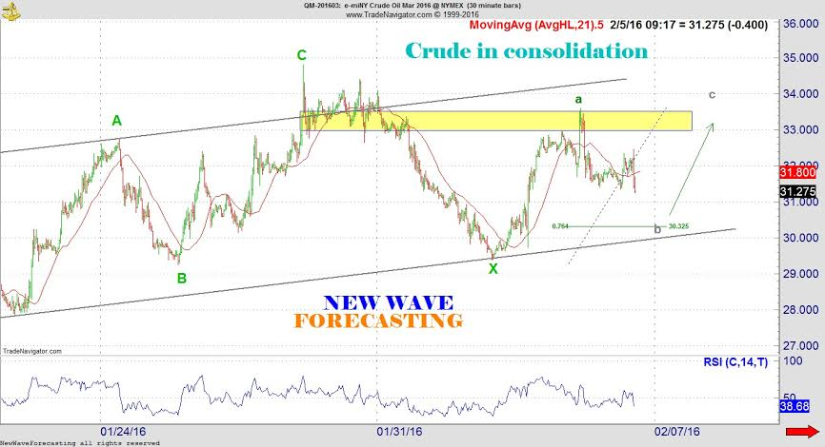
Crude 31.30 and lower still
09:17 2.5.16
I have nothing new to add in the Crude which I think is working on a sizable triangle of its own. The lower 76 is just above 30.25 and could easily get a visit here and we will see if a test of the channel sets up and holds.

Slide 9
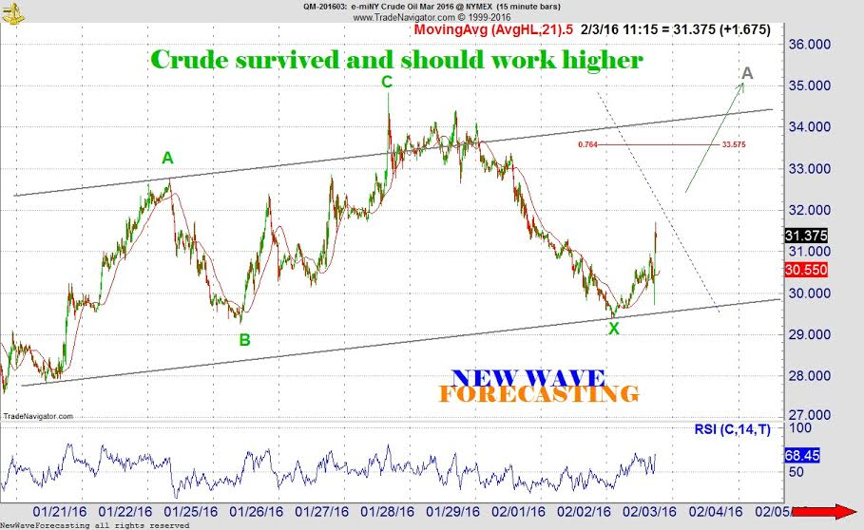
Crude 31.30 and the bottom snuck by me
11:15 2.3.16
The X did not quite make the 76% retracement and that is simply that for the X wave as far as I am concerned. I am optimistic that there will be a few opportunities to battle in Crude as it chops higher. I'm initially targeting 33.50 with a shot at 35 to ideally complete a larger fourth wave corrective rally.

Slide 10
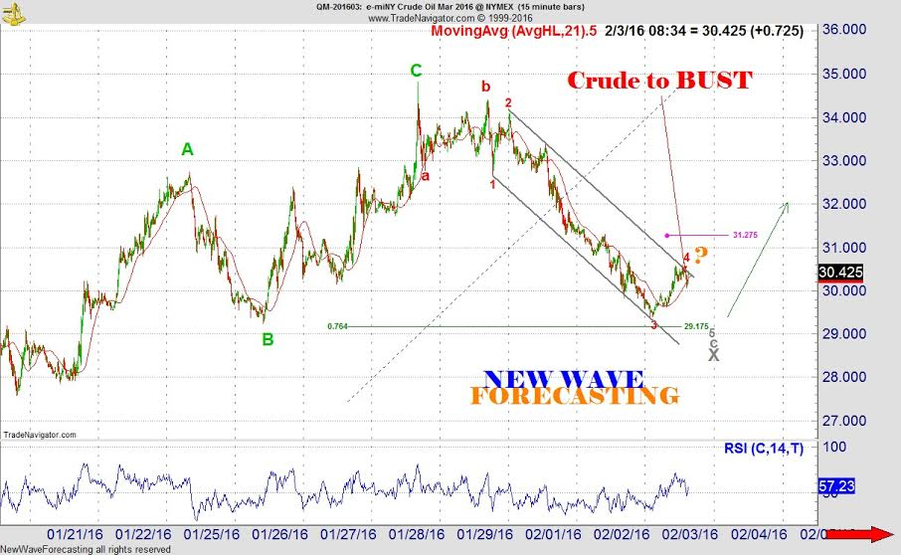
Crude 30.40 and one more low to come
08:34 2.3.16
This is almost exactly how I laid this move out with a spirited wave 4 short scurry. The lower 76% retracement is conveniently situated just below the session low. If the rollover has not already taken place it would be hard to see it happen if prices exceeded 31.25.

Slide 11
Crude 32.00 cautiously optimistic – near term tied to SP
15:38 1.27.16
I suggested there might be support near 31.25 and the spike low came close. If stocks can really come back from the depths of hell, e.g. the 76% retracement within a tick! it certainly wouldn't hurt prospects for a recovery.
Hard to say how many human players are still standing today and what is or isn't "real" at least in crude.

Slide 12
Crude 32.30 probably higher still
11:49 1.27.16
​I have sort of shoehorned in the triangle but if it is a mistake it will be that it is not bullish enough! Not much to say here other than there might be support near 31.25...

Slide 13
Crude 31.40 up as planned, but nearing 76
10:40 1.27.16
The report today was Crude not NatGas but nothing has changed forecast wise in either market. Prices are nearing the upper 76 near 31.80 and if this is a triangle we know prices can not exceed 32.20.

Slide 14
Crude 31.05 higher for now
09:22 1.27.16
I was hoping for a washout of $30 in the presumed triangle consolidation pattern but no so luck...I still like the triangle scenario which would call for an inside day today. The 76 comes in near 31.80 for the anticipated wave d swing.

Slide 15
Crude 30.50 in Consolidation
16:59 1.26.16
The bear trap never set up and the late slide does indicate that the push above 32 was a second wave. I favor the development of a wave B triangle which may not resolve until the storage report Thursday. The more bearish scenario is simply a quick drop towards 28. The lower 76 is sitting just below $30 so the idea of a bear trap comes to mind.

Slide 16
Crude 31.45 Deep Courtesy Dip?
14:30 1.26.16
Prices have backed off about 90 cents and if this a wave iv courtesy dip maybe a small bear trap below 31.50 will set up but if things don't stabilize post-haste.

Slide 17
Crude 32.25 headed to the top of the channel
13:30 1.26.16
There was little selling interest near the $32 76% so my assessment is for a five wave sequence to complete above 33.50 off a midway near 31.50. I suppose if prices were to fall below 31.50 I would have to back off but I view the next 70 cent dip as an opportunity.

Slide 18
Crude 31.90 at key resistance
12:23 1.26.16
The SP did push through its 76 and I think Crude will follow but the first test of $32 might be good for a stall. If this rally structure is wave C as pictured it will simply keep on cruising towards 33.25 with no more than a 75 cent pullback.

Slide 19
Crude 30.55 and going higher
08:48 1.26.16
The setback in Crude held close to the 62% retracement and a conventional support line. I read this to be a more bullish setup of A/B in which case wave C should be dynamic. IF the market does follow my map we could have a dip below 30 prior to heading up.

Slide 20
Crude 30.55 Make/Break Time
11:19 1.25.16
The bear trap did set up a nice bounce but it was sub-standard which might be a really bearish indication. I do not believe this market has seen its final bottom and if it crashes and burns from current levels it would not exactly be a surprise and there could be a quick drop washing out $30.

Slide 21
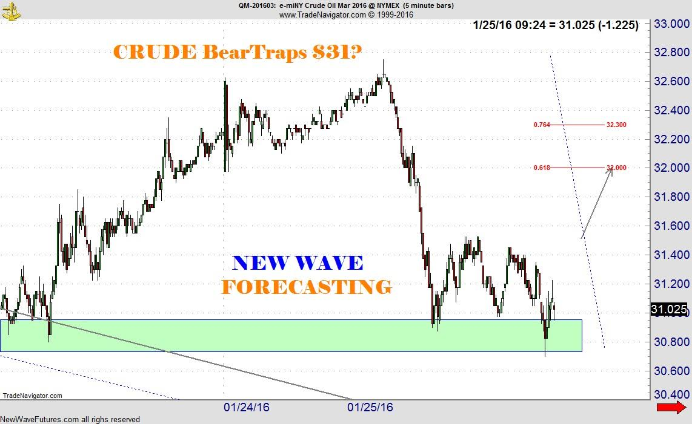
Crude 31.00 courtesy dip for possible bottom
09:24 1.25.16
We should know very soon if Crude put in a sub 31 bear trap. A push above 31.25 would be the first indication that prices may be on their way back towards $32.

Slide 22
Crude 31.65
09:28 1.22.16
Its now obvious the bottom is of larger degree and prices are headed higher still. $32 might find selling interests but the top of the down channel is close to $34. I would be surprised if prices even fall back below $31 from here.

Slide 23
Crude above $31 and toppy looking
09:00 1.22.16
It strikes me after a bi pop that a bull trap setup above $31 makes sense. This pattern may be more bullish than previously thought but that can only be determined if prices actually go down.
Maybe Crude is headed higher from current levels but I am cautious.

Slide 24
Crude 29.65
14:45 1.21.16
The setback from $30+ came right on schedule leaving an almost mandatory bull trap. So far the dip has held a 38% retracement of the extended wave which is bullish and suggests that there is at least one more sub wave higher. This is a risk/reward play because there is a chance that things are not even bullish at all and $30 the figure is clearly the price to watch.

Slide 25
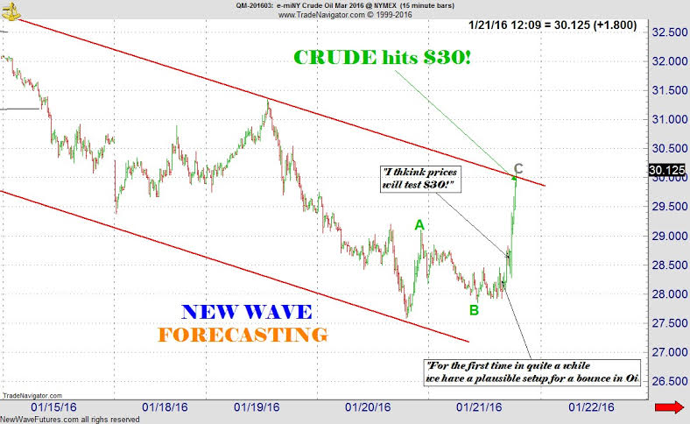
Crude hit $30! Who could have seen that one coming?
12:09 1.21.16
I have not been covering Crude every day but I have obviously been watching! This turned out to be another spectacular forecast with the initial target already met. The way things are going near vertical it is not for me to say further gains aren't forthcoming but if there is going to be a stall it could come from near current levels.

Slide 26
Crude $28.65 BOUCNING!
10:14 1.21.16
This may turn out to be my best call today as the Oil market heads up. I may be way too bullish but I think prices are going to test $30!

Slide 27
Crude Bounce Time?
09:15 1.21.16
For the first time in quite a while we have a plausible setup for a bounce in Oil. The chart is somewhat similar to equities and I must point out that the suspect low is so far un-confirmed making this a very aggressive market call even if risk is limited.
The interests in this market seem to be focused on the "evens and the halves" as players grasp for additional guidance.

